Slide 1


DEPARTMENT OF COMPUTER SCIENCE & ENGINEERING
SCHOOL OF COMPUTING
10214CS601 MINOR PROJECT -1
SUMMER SEMESTER(2024-2025)
REVIEW-II
“AI – DRIVEN HEALTH MANAGEMENT”
SUPERVISED BY
PRESENTED BY
Dr. R.ROSELIN KIRUBA, M.E , PhD
Assistant Professor.
C.NAGENDRA (VTU22016)(22UECM0043)
B.RAJU (VTU21815)(22UECM0022)
P.DURGA PRASAD (VTU21988)(22UECM0207)

Slide 2
OVERVIEW
ABSTRACT
OBJECTIVE
INTRODUCTION
LITERATURE REVIEW (SOFT COPY OF PAPERS TO BE LINKED AS HYPERLINK)
DESIGN AND METHODOLOGIES
IMPLEMENTATION
TESTING
INPUT AND OUTPUT
INCLUDE DEMO VIDEO-1 (Till REVEW-1)
INCLUDE DEMO VIDEO-2(Complete Implementation of Project)
CONCLUSION
WEB REFERENCES LINK (TILL REVIEW DATE ALL LINKS TO BE INCLUDED DAY WISE)
PLAGIARISM REPORT OF PPT
REFERENCES

Slide 3
ABSTRACT
AI-Driven Health Management help users analyze their symptoms and receive preliminary diagnoses.
This project focuses on building a rule-based Symptom Analyzer that offers users healthcare advice in multiple languages, making it more accessible to diverse populations.
The goal of the project is to create a web-based application where users can input symptoms, get potential disease predictions based on a pre-built dataset, and retrieve detailed disease information (including causes, treatments, and remedies) in various languages.
This enhances healthcare accessibility and provides basic guidance for early detection.
The system employs a rule-based approach for matching user symptoms against a Symptom-Disease Dataset.
The backend is built using Python frameworks , and a relational database is used to store multilingual disease information.
The frontend interface allows users to input symptoms and switch between languages via a user- friendly design.

Slide 4
The disease information is stored in multiple languages under the same disease key in the database, and users can switch between different translations seamlessly.
The system successfully matches symptoms to diseases and retrieves accurate, detailed information about each identified disease in the user's preferred language.
It ensures accessibility for non-English-speaking users, and the language-switching feature works seamlessly across various devices.
The project offers basic healthcare assistance, helping users make informed decisions about their health.
The Symptom Checker provides a functional solution for delivering healthcare information in a user-friendly and multilingual format.
While the rule-based system effectively addresses common symptoms, future enhancements can include Natural Language Processing (NLP) and machine learning for improved accuracy and flexibility.
This system forms a foundation for more advanced healthcare diagnostic tools.

Slide 5
OBJECTIVES
1. Aim of the Project
The aim of this project is to develop a rule-based Symptom Checker that allows users to input their symptoms, receive a potential disease diagnosis, and access detailed disease-related information (such as causes, treatments, and remedies) in multiple languages.
The project focuses on providing a simple yet accessible healthcare tool for users to gain insight into their health conditions, particularly enhancing usability through multilingual support for diverse audiences.
2. Scope of the Project
The scope of this project includes:
Building a web-based application with a user-friendly interface for symptom input.
Implementing a rule-based logic system to match user symptoms to diseases based on a predefined symptom- disease dataset.

Slide 6
Storing detailed disease information (cause, treatment, home remedies) in a multilingual database, with each disease's information available in multiple languages.
Providing language-switching functionality, allowing users to easily view disease information in their preferred language.

Slide 7
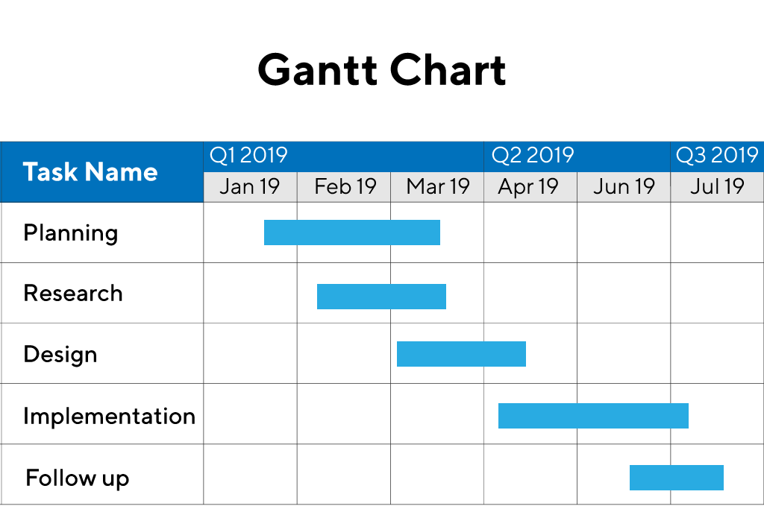
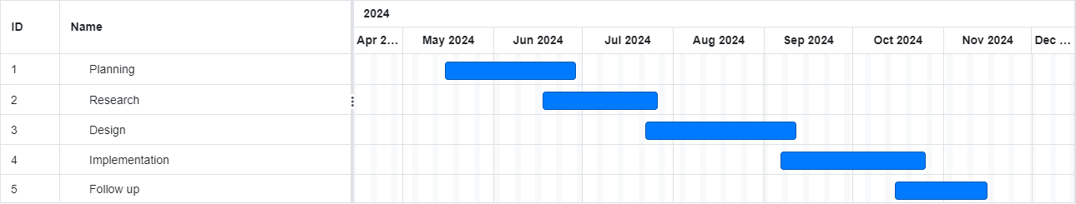
TIMELINE OF THE PROJECT
Sample Gantt Chart
Include as GANTT CHART
Include timeline from October 2023 to January 2024.

Slide 8
INTRODUCTION
In today’s digital age, accessibility to reliable and user-friendly healthcare information is more important than ever.
A Symptom Checker offers a solution by providing users with an easy way to input their symptoms and receive potential disease diagnoses.
The aim of this project is to create a rule-based web application that not only predicts diseases based on symptoms but also provides detailed disease information in multiple languages, enhancing its usability for non-English speakers.
With the rise in the use of technology in healthcare, such tools can play a crucial role in early disease detection and promoting health awareness.
This project addresses the challenge of healthcare accessibility by offering multilingual support, allowing users from diverse linguistic backgrounds to access healthcare information.
The system will store detailed disease information such as causes, treatments, and home remedies, which users can view in their preferred language at the click of a button.

Slide 9
LITERATURE REVIEW
Sl.No | Author’s Name | Paper name and publication details | Year of publication | Main content of the paper
1 | S Aboueid | The Use of Artificially Intelligent Symptom checkers by University Students–An Exploratory Sequential Mixed Methods Study | 2021 | Rising healthcare costs, wait times, unnecessary care, and lack of access to a primary care provider, are pressing issues encountered by various health systems and in part, are a result of misinformed patient demand. The literature suggests that one way to economize the healthcare system is to provide patients with reliable tools to inform better decisions on when to seek care. The Internet is often used as a source of health information. University students, a population group considered to be technology savvy, often browse the Internet for health topics and self-diagnosis

Slide 10
Sl.No | Author’s Name | Paper name and publication details | Year of publication | Main content of the paper
2 | CH Tsai, Y You, X Gui, Y Kou, JM Carroll | Exploring and promoting diagnostic transparency and explainability in online symptom checkers | 2021 | Online symptom checkers (OSC) are widely used intelligent systems in health contexts such as primary care, remote healthcare, and epidemic control. OSCs use algorithms such as machine learning to facilitate self-diagnosis and triage based on symptoms input by healthcare consumers.
3 | C Woodcock, B Mittelstadt, D Busbridge | The impact of explanations on layperson trust in artificial intelligence–driven symptom checker apps: experimental study | 2022 | The aim of this study is to ascertain whether explanations provided by a symptom checker affect explanatory trust among laypeople and whether this trust is impacted by their existing knowledge of disease.

Slide 11
Sl.No | Author’s Name | Paper name and publication details | Year of publication | Main content of the paper
4 | You, Yue | Self-diagnosis through chatbot-based symptom checkers: user experiences and design considerations | 2020 | Developing Artificial Intelligence (AI)-based chatbots in the healthcare market, which use human-like conversations to interact with users
5 | Y You, R Ma, X Gui | User experience of symptom checkers: a systematic review | 2022 | aiming to characterize users studied in the existing literature, identify the aspects of user experience of symptom checkers that have been studied, and offer design suggestions.

Slide 12
Sl.No | Author’s Name | Paper name and publication details | Year of publication | Main content of the paper
6 | Nikita Vijay Shinde; Aniket Akhade; Pranali Bagad; Harshit Bhavsar; S.K. Wagh; Amol Kamble | Healthcare chatbot system using artificial intelligence | 2021 | This paper presents Healthcare Chatbot using Artificial Intelligence that can make a human-system interaction to resolve basic queries regarding health parameters before consulting a doctor. The actual purpose behind this work is to work on the user's symptoms and to provide medical suggestions according to it, to reduce the time and cost required for the process.
7 | Berkay Murat; Arda Oğulcan Üzer; Sarp Ketenci; Sinan Yaşbek; İlker Korkmaz | A Symptom Evaluation System on Medical Diagnosis | 2023 | The Symptom Evaluation System (SES) to be used on medical diagnosis is a software application that offers time-saving solutions to the problems regarding the communication and the relationship between patients and doctors.

Slide 13
Sl.No | Author’s Name | Paper name and publication details | Year of publication | Main content of the paper
8 | Lekha Athota; Vinod Kumar Shukla; Nitin Pandey; Ajay Rana | Chatbot for healthcare system using artificial intelligence | 2020 | Healthcare is very important to lead a good life. However, it is very difficult to obtain the consultation with the doctor for every health problem. The idea is to create a medical chatbot using Artificial Intelligence that can diagnose the disease and provide basic details about the disease before consulting a doctor.

Slide 14
DESIGN AND METHODOLOGIES
MODULE 1: Data Collection
MODULE 2: Algorithms
Rule-Based Matching Algorithm
Pattern Matching (String Matching)
Natural Language Processing (NLP) Techniques
Database Querying Algorithm

Slide 15
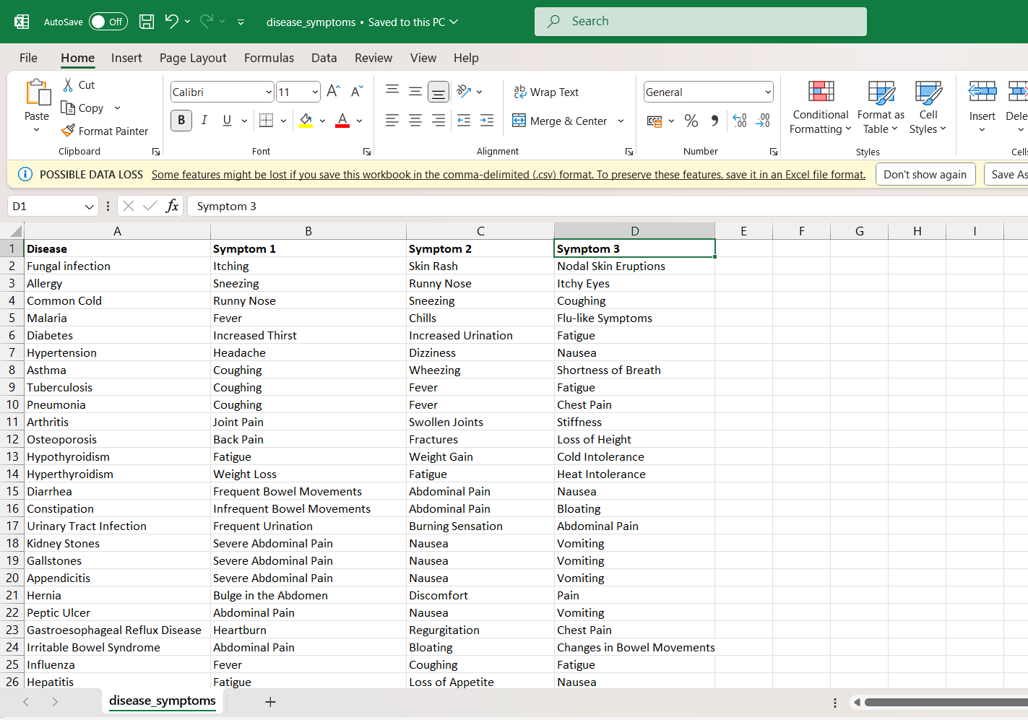
MODULE 1: Data Collection
Step:1 Collection of data
Symptom – Disease data set which is having number of diseases and their respective symptoms

Slide 16
Module 2- Mention the algorithm
1. Rule-Based Matching Algorithm
Description: This is the core algorithm used to match user-inputted symptoms to a set of predefined symptoms for each disease in the dataset. It works by checking for exact or close matches between the symptoms provided by the user and the stored dataset.
2. Pattern Matching (String Matching)
Description: This technique is used to process user input and identify symptoms even if they are phrased differently or contain slight variations.
3. Natural Language Processing (NLP) Techniques (Optional Future Enhancement)
Description: If the system is upgraded, NLP can be used to process and interpret free-text symptom inputs, rather than requiring structured inputs.
4. Database Querying Algorithms
Description: This algorithm retrieves disease information (e.g., causes, treatments, and remedies) from a multilingual database after the symptom match is made.

Slide 17
IMPLEMENTATION
Architecture Diagram
Data –Flow Diagram
Use Case Diagram
Class Diagram
Activity Diagram
Sequence Diagram
Collaboration Diagram(If applicable)
E-R Diagram
It’s a sample only and may vary according to the project

Slide 18
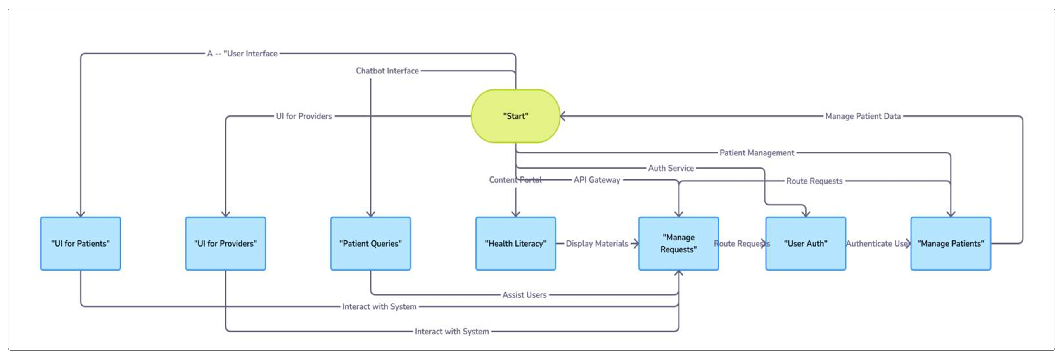
Architecture Diagram

Slide 19
User Interface: Allows users to input symptoms and select a preferred language.
Backend: Processes the input, matches symptoms to diseases using the rule-based algorithm, and queries the database.
Symptom-Disease Dataset: Contains the predefined symptom-disease mappings for rule-based matching.
Disease Information Database: Stores detailed disease information in multiple languages.
Process Flow: Starts with symptom input, followed by language selection, symptom matching, and the retrieval of disease information from the database, which is displayed in the chosen language.

Slide 20
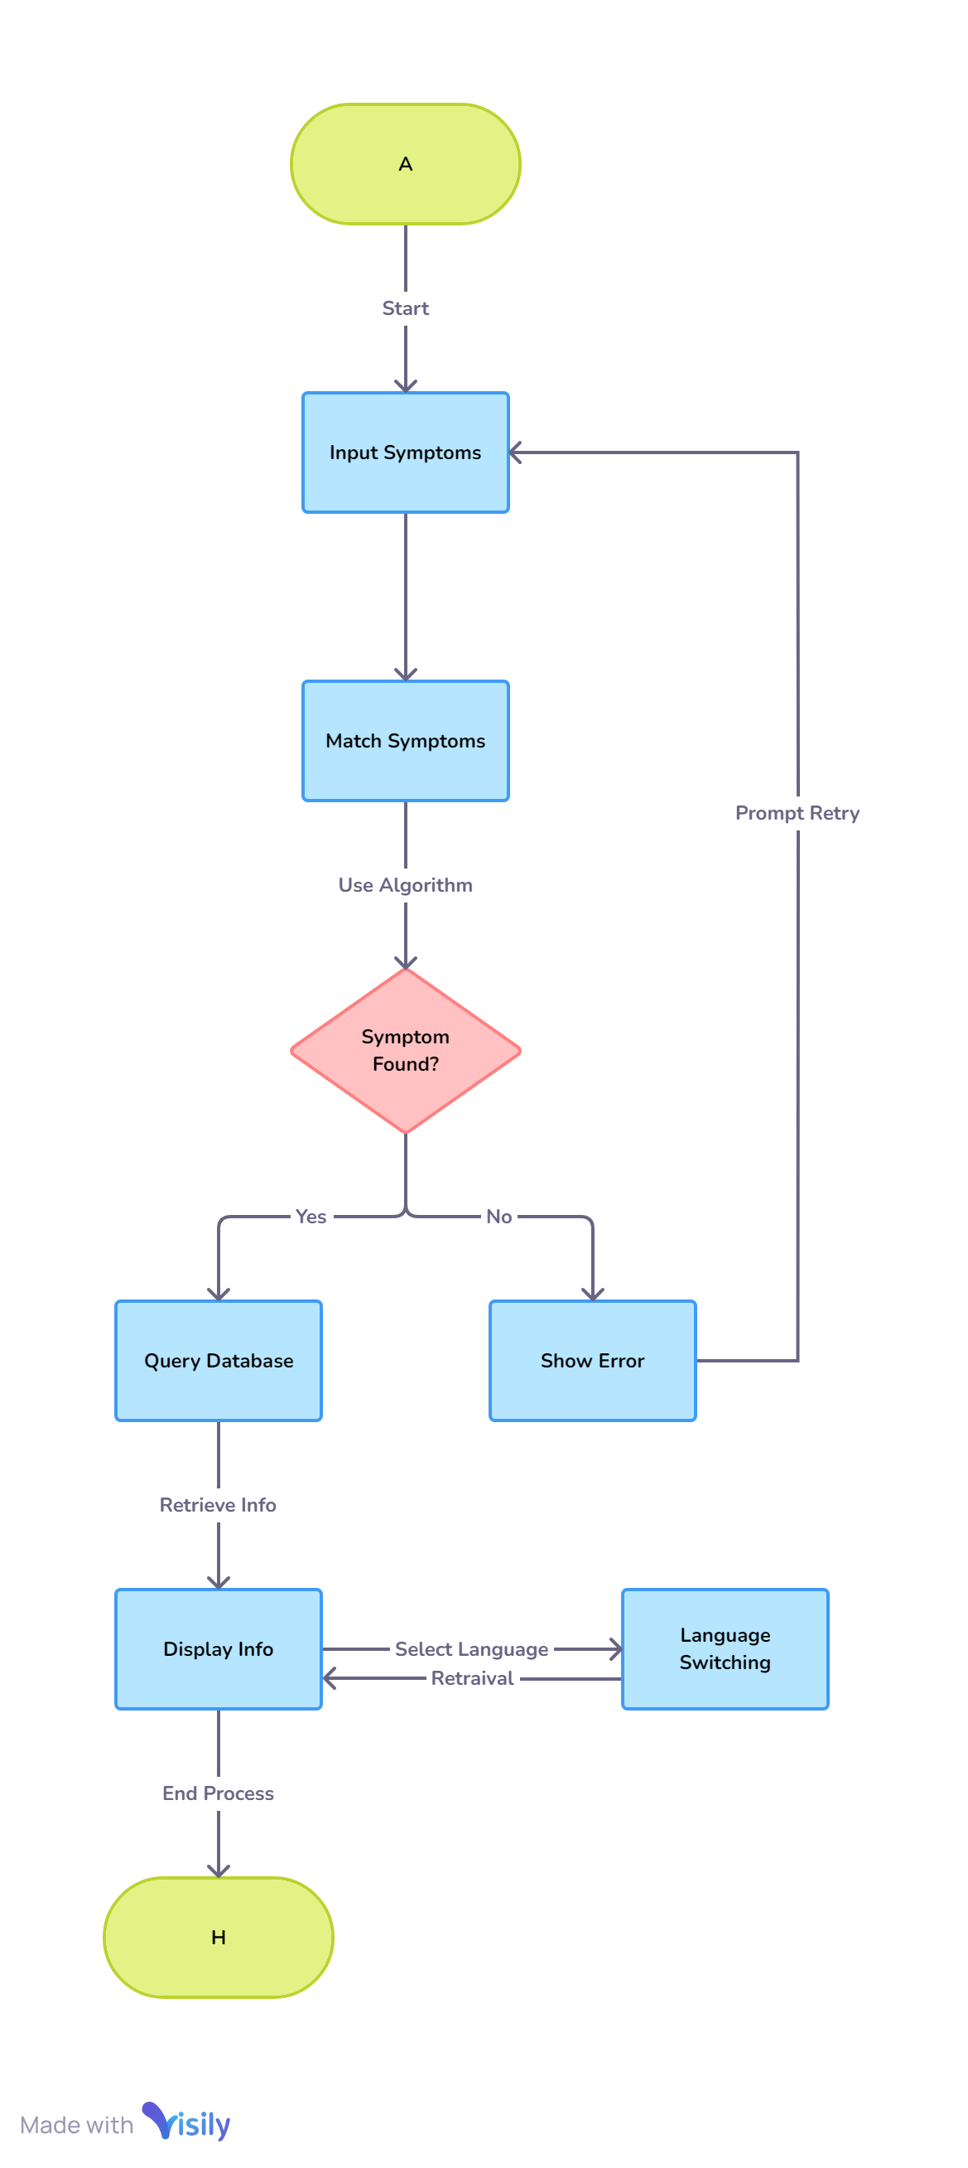
Data –Flow Diagram
User Interface: Allows users to interact the system ,they can input their symptoms and select a preferred language that the information should be displayed.
Backend: Processes the input, matches symptoms to diseases using the rule-based algorithm, and queries the database for information.
Symptom-Disease Dataset: Contains the predefined symptom-disease mappings for rule-based matching.
Disease Information Database: Stores detailed disease information in multiple languages.
Process Flow: Starts with symptom input, followed by language selection, symptom matching, and the retrieval of disease information from the database, which is displayed in the chosen language.

Slide 21
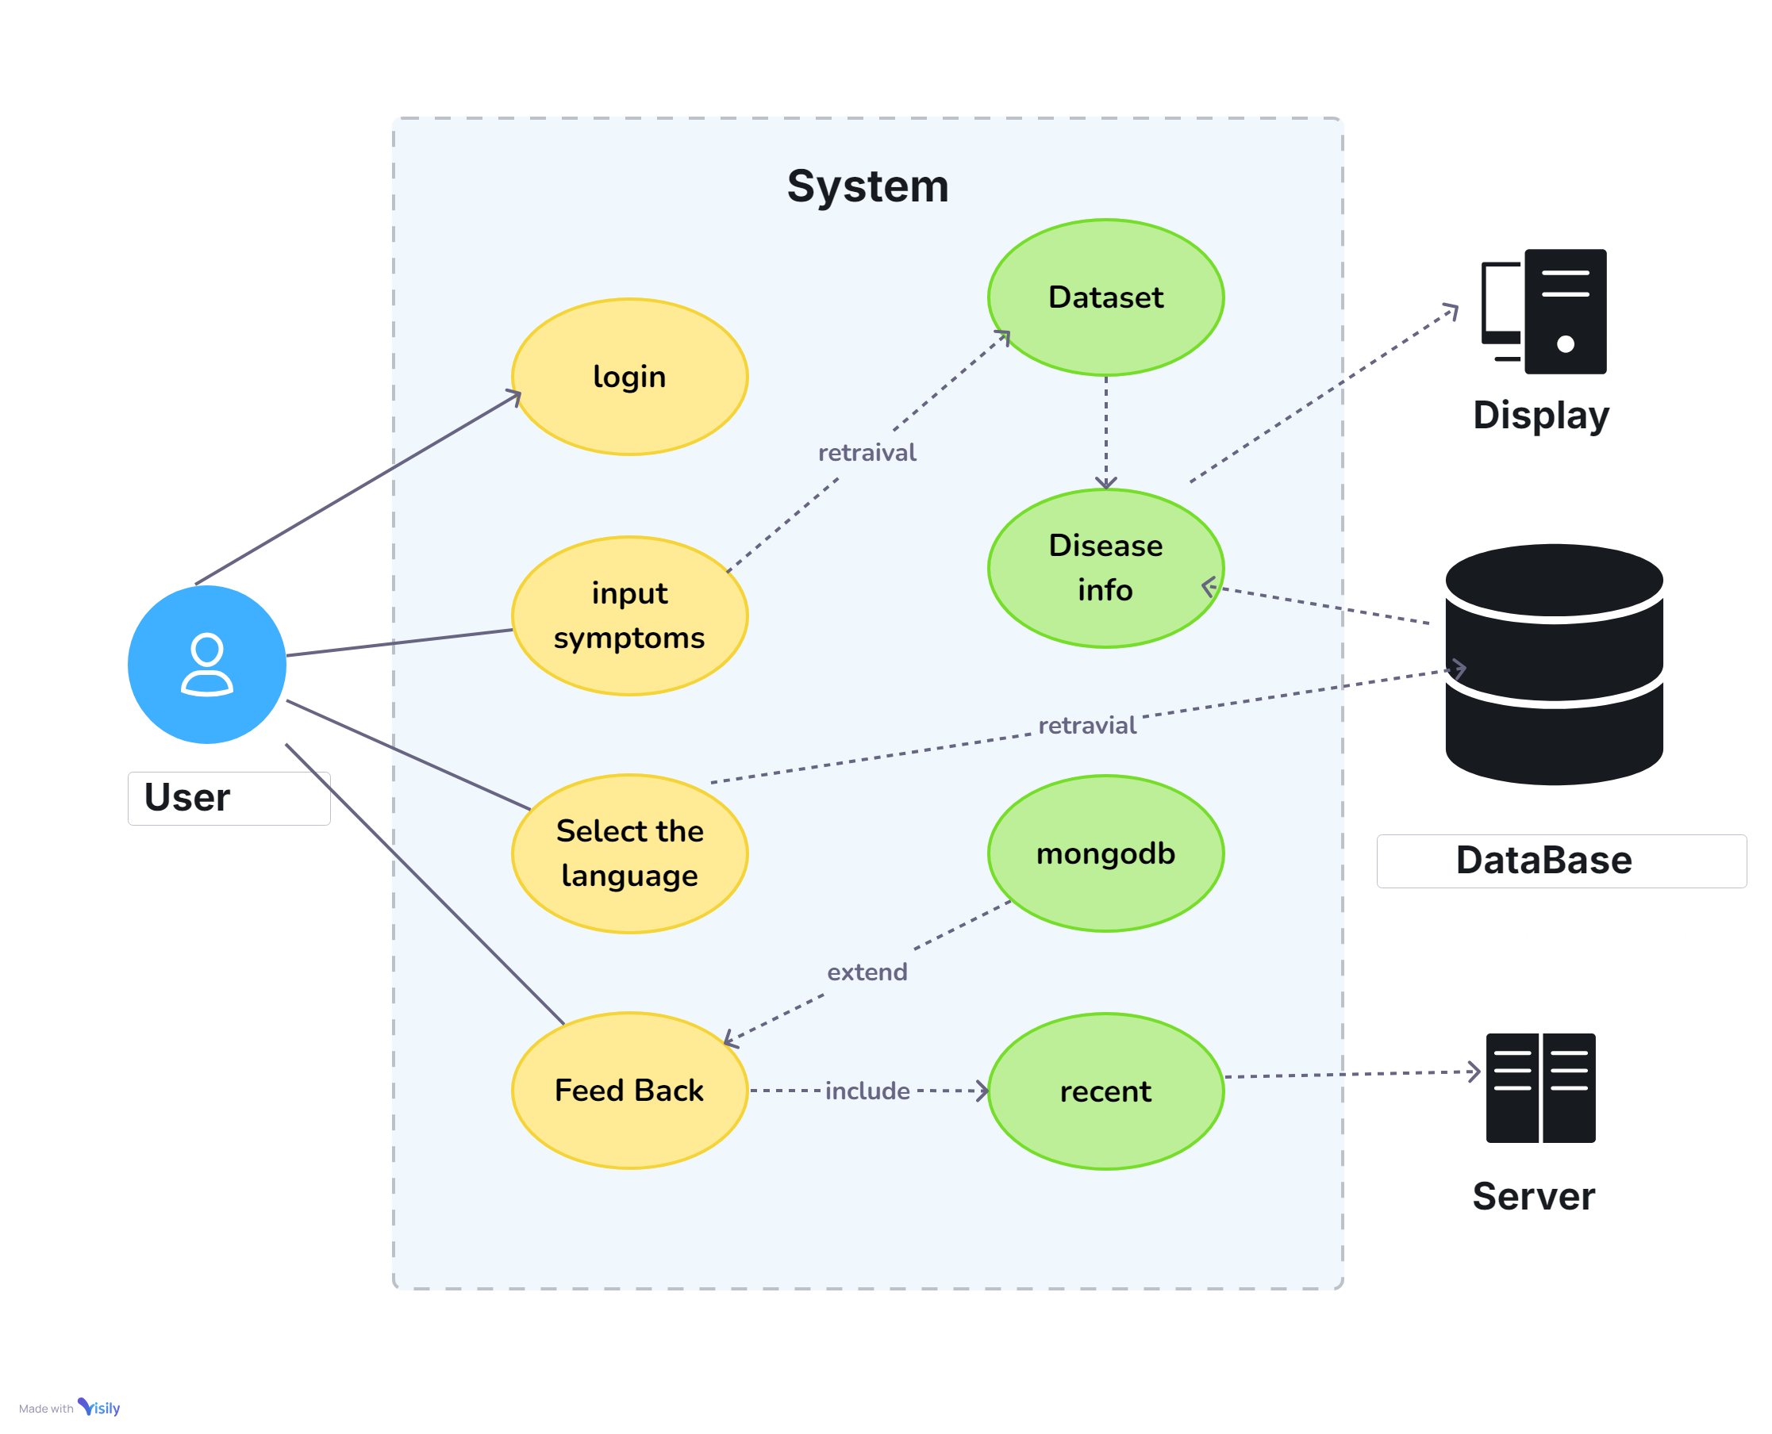
Use Case Diagram
Inputs symptoms into the system.
Selects a preferred language for viewing disease information.
Receives a potential diagnosis from the symptom matching engine.
Views detailed disease information, including causes and treatments.
Switches between languages to view the disease information in their preferred language

Slide 22
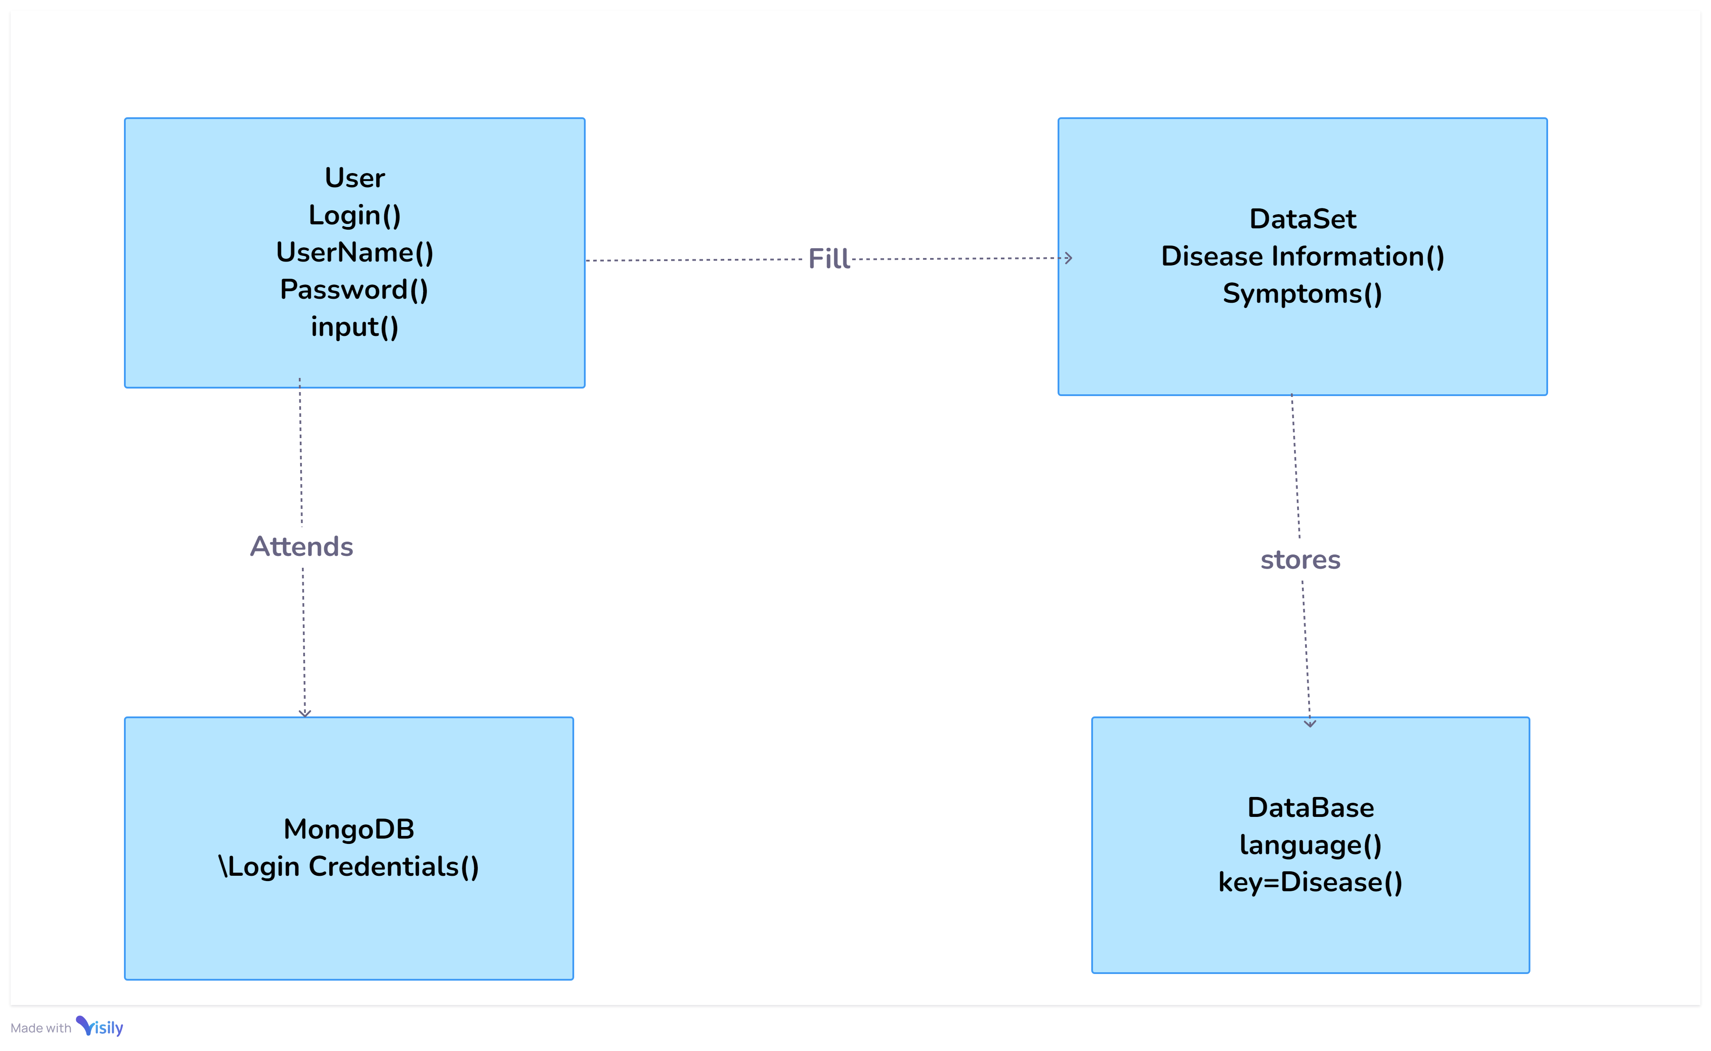
Class Diagram
User: Represents the user of the system, who inputs symptoms and selects a language.
Symptom Checker(Data Set): The main engine that interacts with the user input and performs operations like symptom matching.
Symptom Matcher: A class responsible for comparing user input with the symptom-disease dataset.
Disease Database: Stores disease information in multiple languages.
Disease: Contains detailed disease data, including causes, treatments, and remedies.
Language (database): Handles multilingual support, allowing disease information to be presented in different languages.
Mongo DB:To verify the login (user name and password)

Slide 23
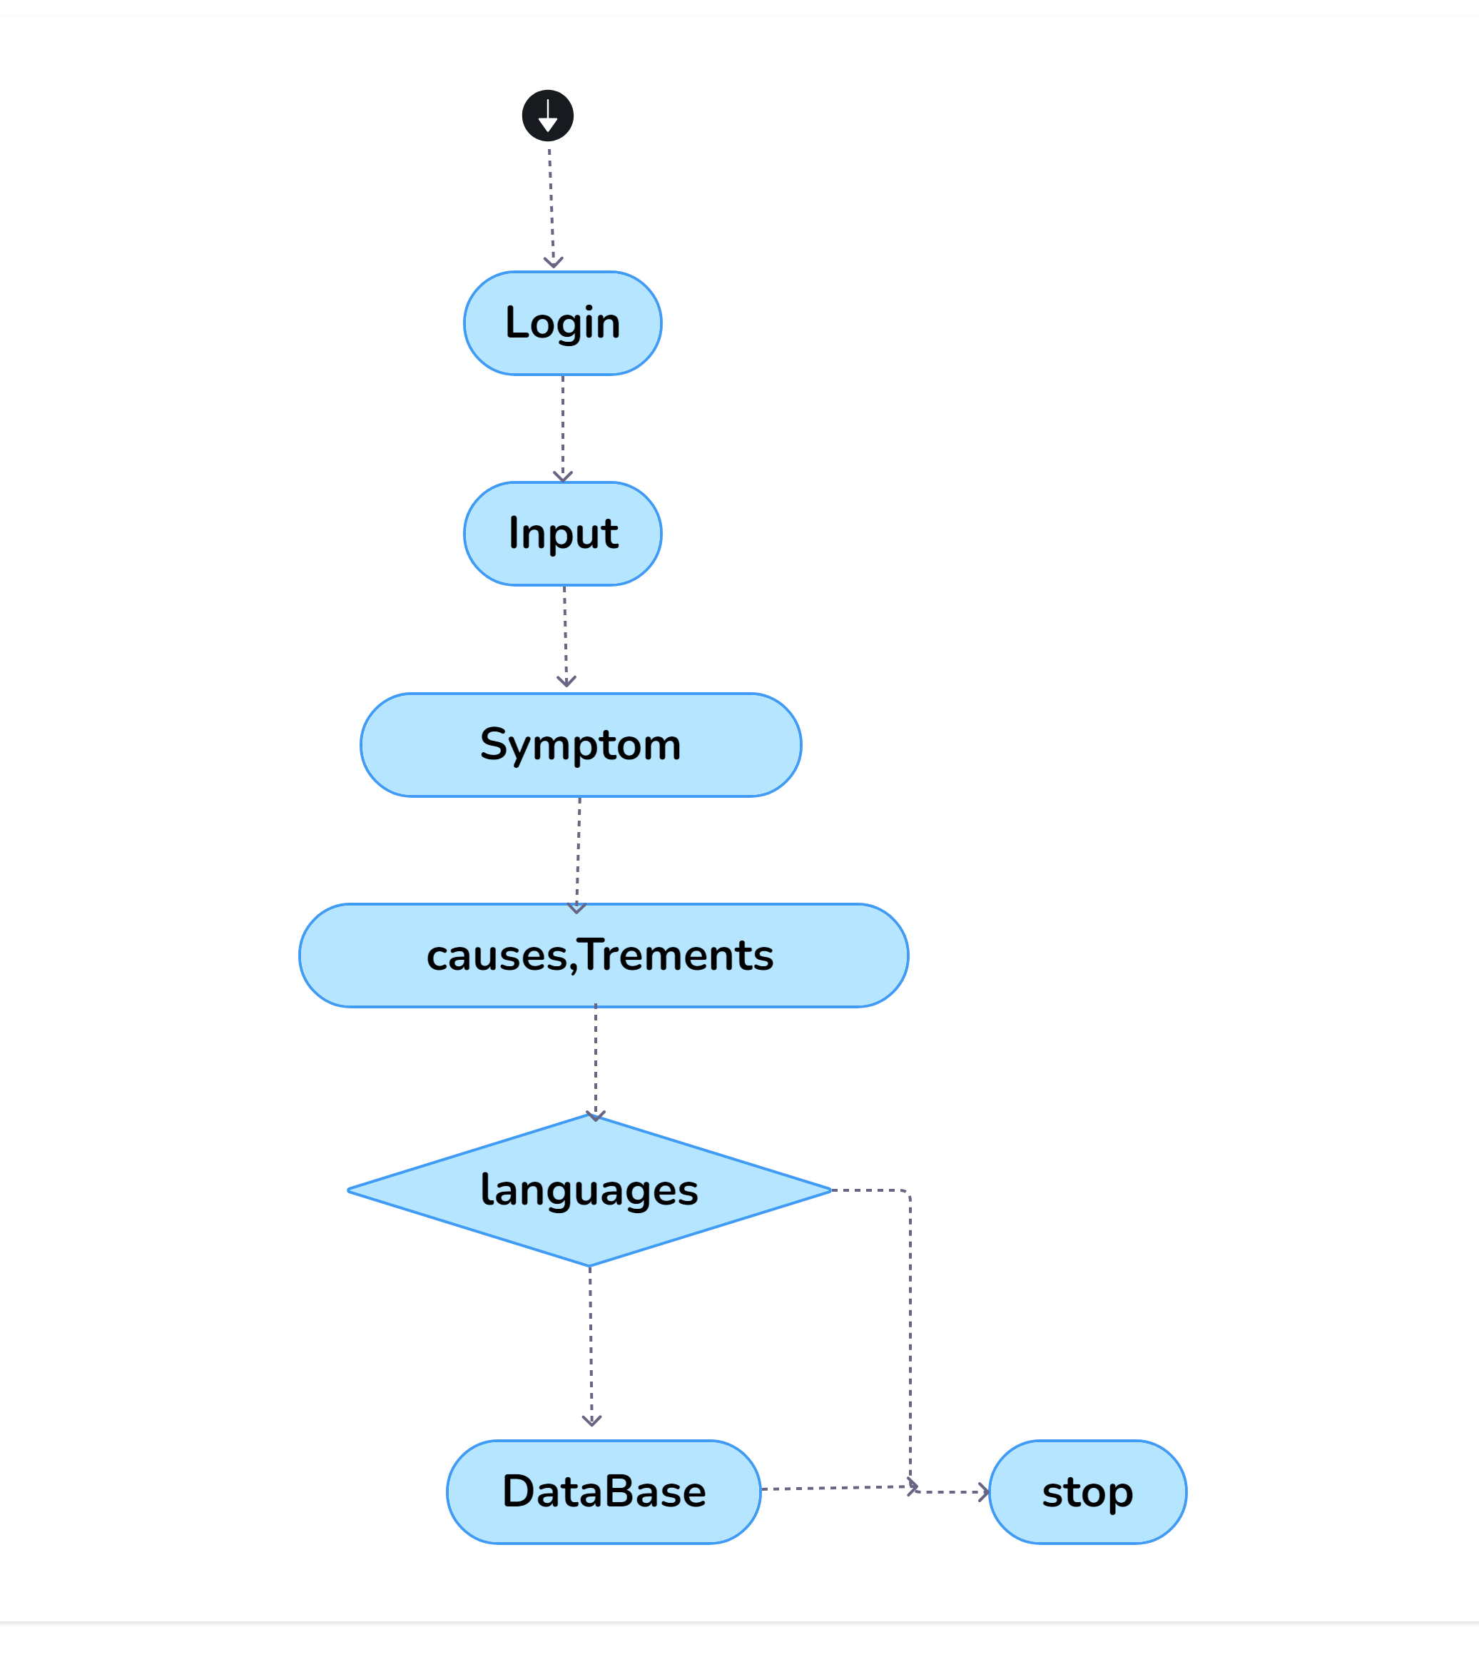
Activity Diagram
User Inputs Symptoms: The user starts by entering their symptoms into the system. This triggers the backend process to handle the input.
Symptom Processing: The system receives the symptoms and begins processing them. This may involve basic pattern matching or rule-based checks to match symptoms with potential diseases.
Symptom-Disease Matching: The system compares the user’s symptoms with a predefined dataset of symptoms and their associated diseases. If a match is found, the system retrieves the relevant disease(s).
Language Selection: If multilingual support is enabled, the user selects their preferred language. The system checks the database for the corresponding disease information in the chosen language.
Retrieve Disease Information: Once the matching disease is found, the system retrieves detailed information from the database in the selected language.

Slide 24
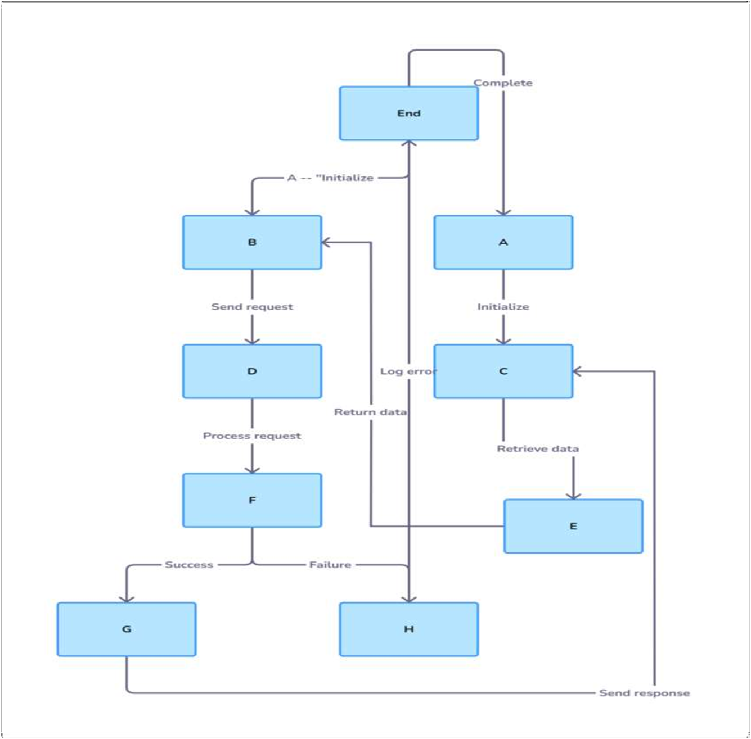
Sequence Diagram
,

Slide 25
User Input: The sequence starts when the user inputs their symptoms into the system via the user interface. This action initiates a request for symptom analysis.
Symptom Checker (Front-end): The user input is sent to the Symptom Checker engine. This component handles the request and forwards the symptoms to the backend for processing.
Symptom Matching (Backend): The backend matches the input symptoms to diseases by querying the Symptom-Disease Dataset. It uses a rule-based algorithm or pattern matching to find potential matches based on the symptoms.
Disease Database Query: Once a disease match is found, the backend retrieves the corresponding disease information from the Disease Information Database. The database stores disease-related information such as causes, treatments, and home remedies, with multilingual support.
Language Selection: If the user has selected a preferred language, the system retrieves the information in the selected language from the database. If no language is selected, the default language is used.
Optional Language Switch: The user can optionally switch the language at this point, triggering a new request to retrieve the same disease information in another language. The system queries the database again for the appropriate language version and displays it to the user.

Slide 26
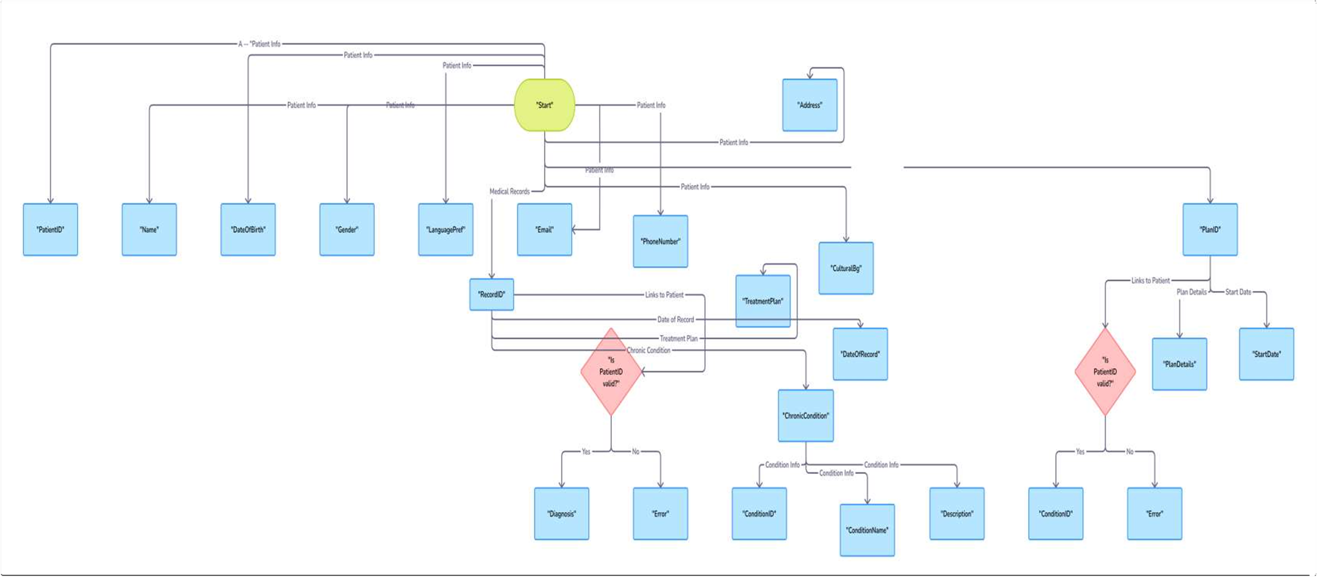
E-R Diagram

Slide 27
Entities:
User: Represents the user who interacts with the system by entering symptoms and selecting a preferred language.
Symptom: Captures the symptoms entered by the user. Each symptom is related to one or more diseases.
Disease: Stores information about diseases, including causes, symptoms, treatments, and home remedies.
Language: Contains the various languages available for viewing disease information.
Disease Information: Includes the detailed descriptions of causes, symptoms, treatments, and remedies, available in multiple languages.
Symptom-Disease Mapping: An associative entity that maps symptoms to potential diseases based on predefined rules.
Relationships:
User Input: A user inputs symptoms, which are matched to diseases using the rule-based engine.
Has Symptom: Each disease is linked to one or more symptoms.

Slide 28
Has Disease Info: Each disease has corresponding disease information (cause, treatment, home remedies) stored in multiple languages.
Select Language: Users can select a language, and the system retrieves the disease information in the chosen language.
Cardinality:
A User can input multiple symptoms.
A Symptom can be related to multiple Diseases.
A Disease has corresponding information in one or more Languages.
The Symptom-Disease Mapping connects symptoms to diseases in a many-to-many relationship.

Slide 29
TESTING
UNIT TESTING
INTEGRATION TESTING
WHITE BOX TESTING
BLACK BOX TESTING

Slide 30
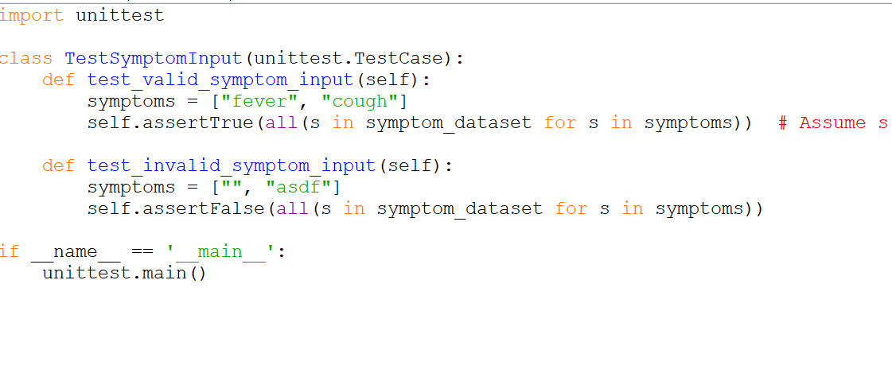
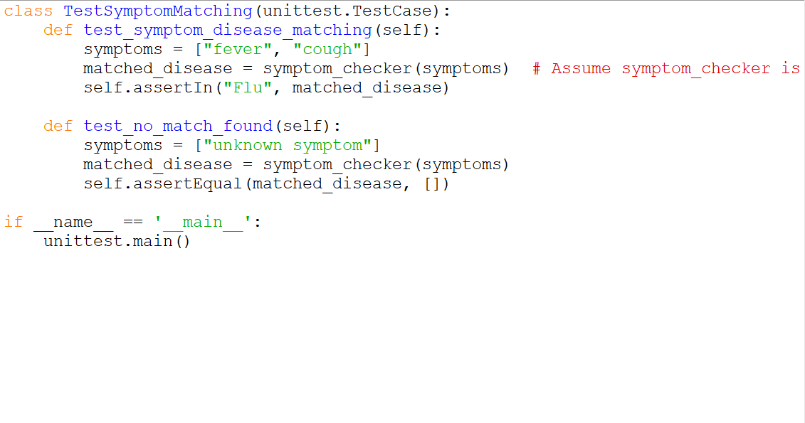
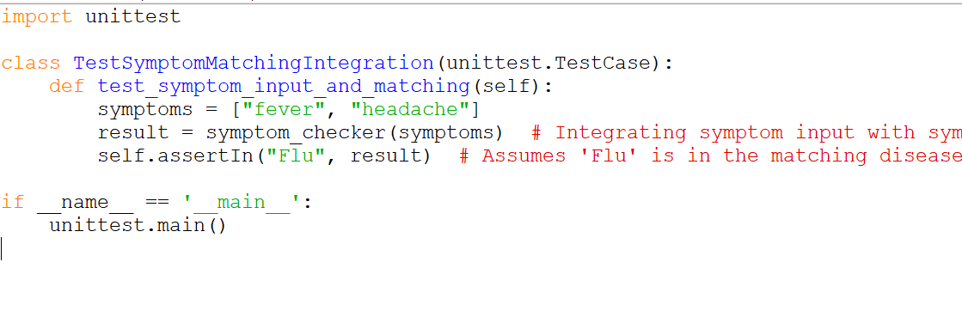
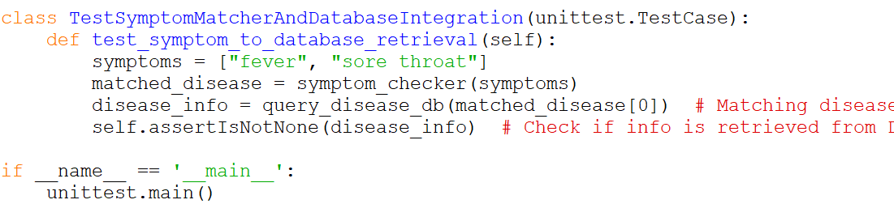
UNIT TESTING
INTEGRATION TESTING

Slide 31
SYSTEM TESTING
Functionality Testing :
Objective: Ensure that all features of the system work as intended
Usability Testing :
Objective: Ensure the system is user-friendly and easy to navigate
Performance Testing :
Objective: Ensure the system performs efficiently under normal and heavy loads
Security Testing :
Objective: Ensure that the system is secure and protects user data.
Compatibility Testing :
Objective: Ensure the system works across different devices, browsers, and operating systems
Multilingual Testing :
Objective: Ensure the system provides accurate disease information in different languages

Slide 32
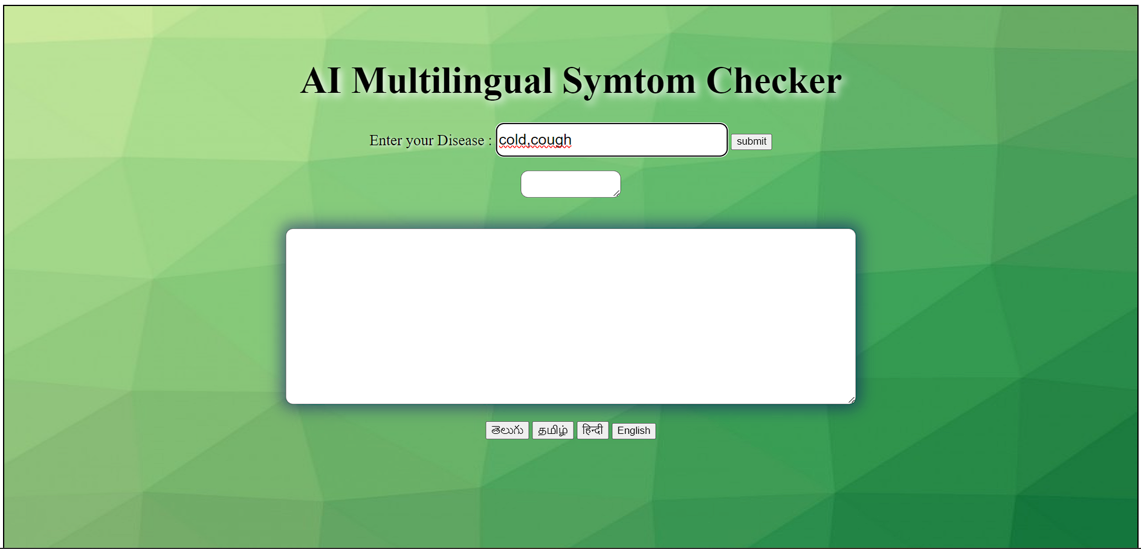
INPUT AND OUTPUT

Slide 33
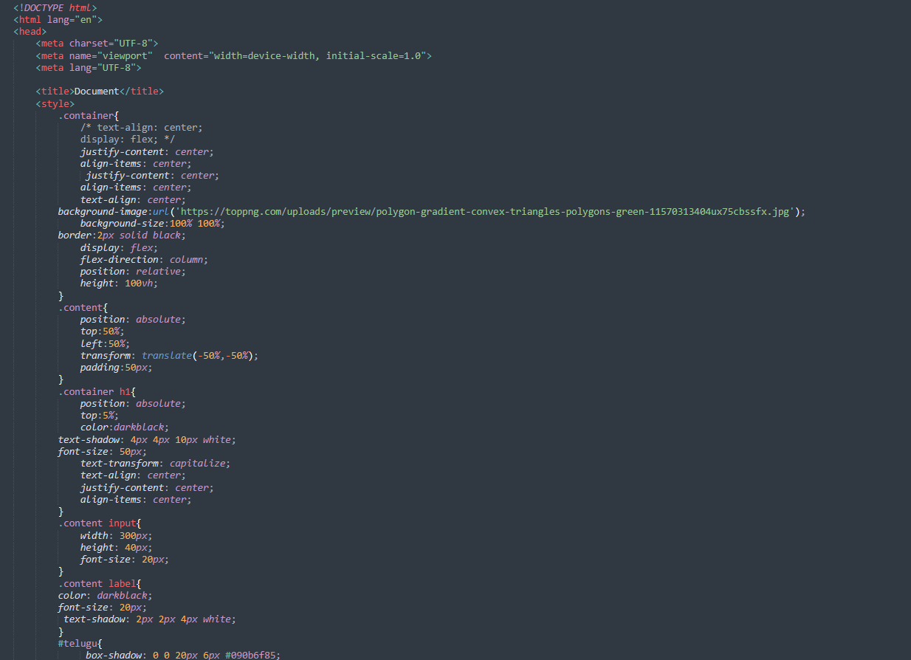
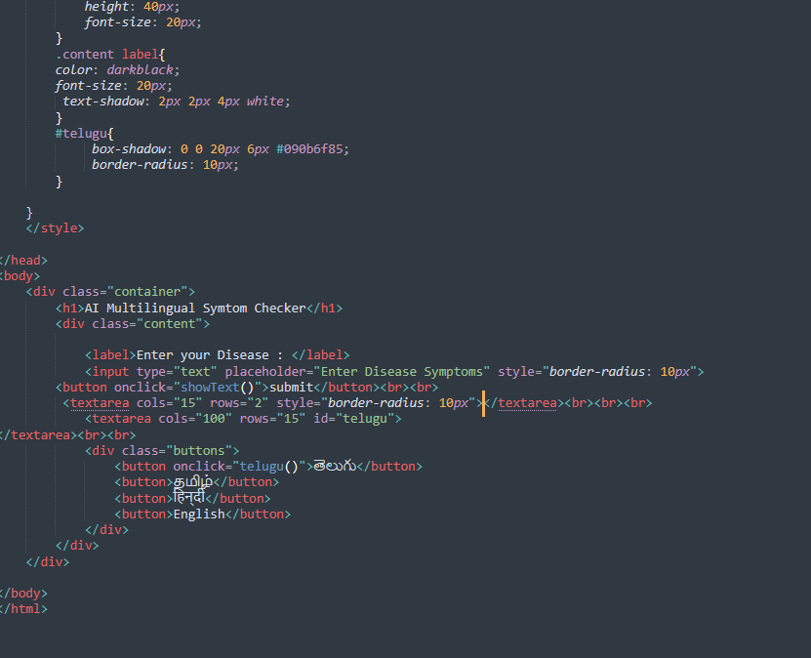
SOURCE CODE

Slide 34
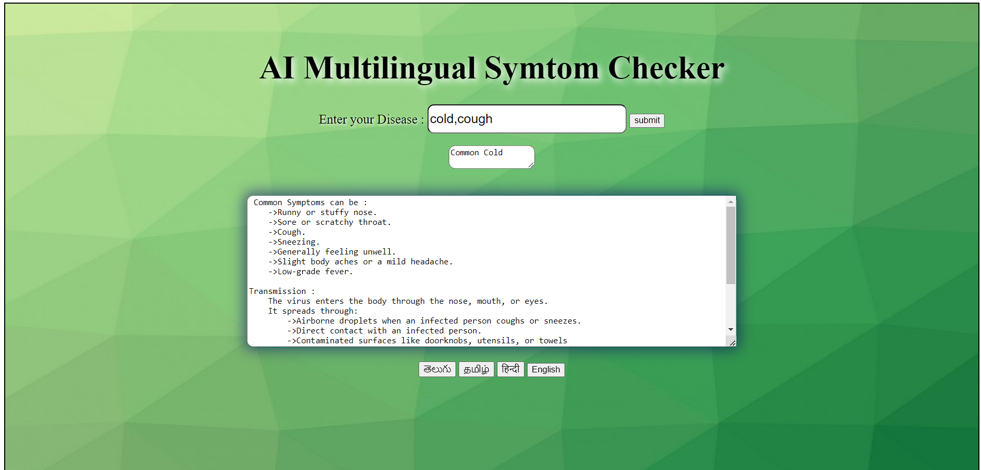
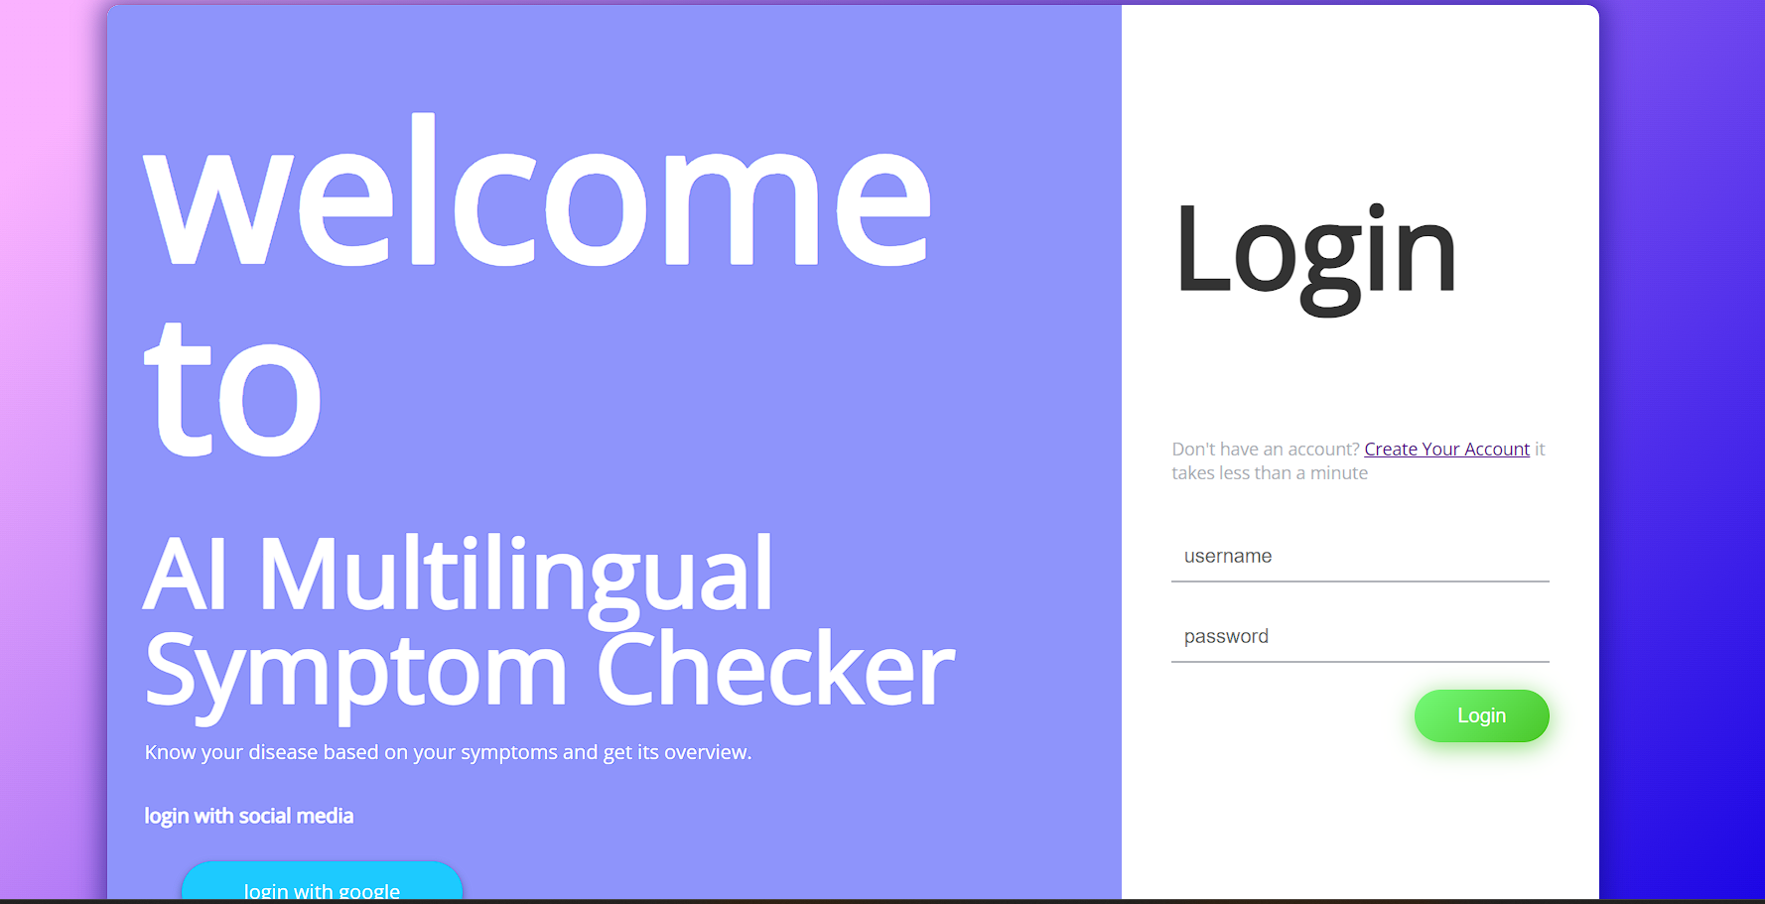
OUTPUT

Slide 35
CONCLUSION
The Symptom Checker project successfully implemented a basic rule-based system capable of analysing user-inputted symptoms and providing potential diagnoses. By integrating a symptom-disease dataset and a multilingual disease information database, the system proved effective in offering users healthcare information in their preferred language, enhancing accessibility and user experience.
The project demonstrated that rule-based systems can effectively manage common symptoms and provide accurate disease predictions. However, the system's limitations, such as handling ambiguous inputs or rare diseases, highlighted the potential for further improvements. Future enhancements, including the incorporation of Natural Language Processing (NLP) and machine learning models, could significantly improve the accuracy and flexibility of the system. Additionally, expanding the dataset and improving translation accuracy will make the tool more comprehensive and useful for a wider audience.
In conclusion, the project achieved its goal of building a functional, multilingual symptom checker while laying the groundwork for future enhancements that could transform it into a more sophisticated healthcare solution.

Slide 36
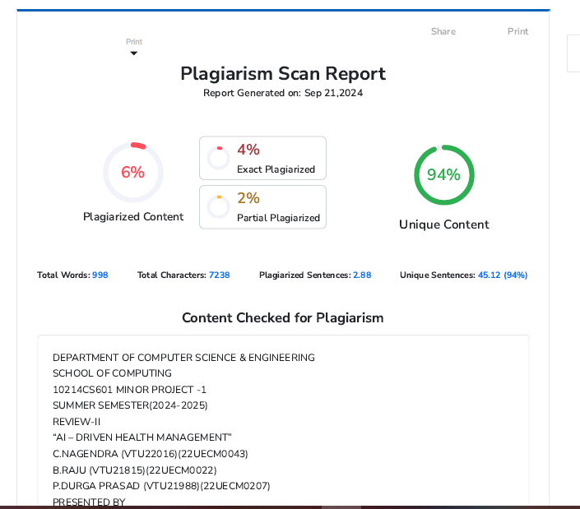
Plagiarism Report of PPT

Slide 37
Web references/video links
https://youtube.com/playlist?list=PLfFghEzKVmjuhQwKhYXvdU94GSU-6Jcjr&si=0aPFas9u3dshjous
https://youtu.be/GtyBiNMZtQo?si=FRp8GHjJvK8B-6zn
https://youtu.be/Lq6ik1WHRtQ?si=M8iVIOQ2SpyucbR7

Slide 38
REFERENCES
[1] A Smart Research Framework for Local Undergraduate Colleges’ Literacy Survey Based on
Distributed Data Collection SystemZili Niu2022 Second International Conference on Artificial Intelligence and Smart Energy (ICAIS)
[2] Exploring the Role of the Internet, Quality and Communication in Shaping Mental Health:
Analysis of the Information National Trends Survey Avishek Choudhury;Onur Asan;Turki Alelyani
IEEE Journal of Biomedical and Informatics
[3] Measuring Digital Literacy in Hungary: A Scoping Review Mariann Békésy 2022 IEEE 20th
Jubilee International Symposium on Intelligent Systems and Informatics (SISY)
[4] Artificial Intelligence-Based Education and Management System for Patients with Chronic
DiseasesLingyu Wang;Xi Jiang;Tuaner Zhang;Xiaozhu Wang;K S Shashidhar 2022 International Conference on Knowledge Engineering and Communication Systems (ICKES)

Slide 39
THANK YOU

